Slide 1
Assignment 2
(group 9)

Slide 2
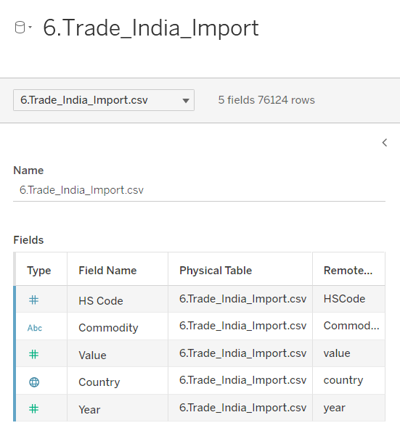
Data Set

Slide 3
This data set contains data regarding the imports of various goods to India from many countries throughout the years 2010-2018.
It has a total of 5 columns and 76124 rows.

Slide 4
Why this data set?
It has only 5 columns so it makes for easy analysis and is simple to understand.
High number of records.
Interesting to see the trends in imports of goods in India.

Slide 5
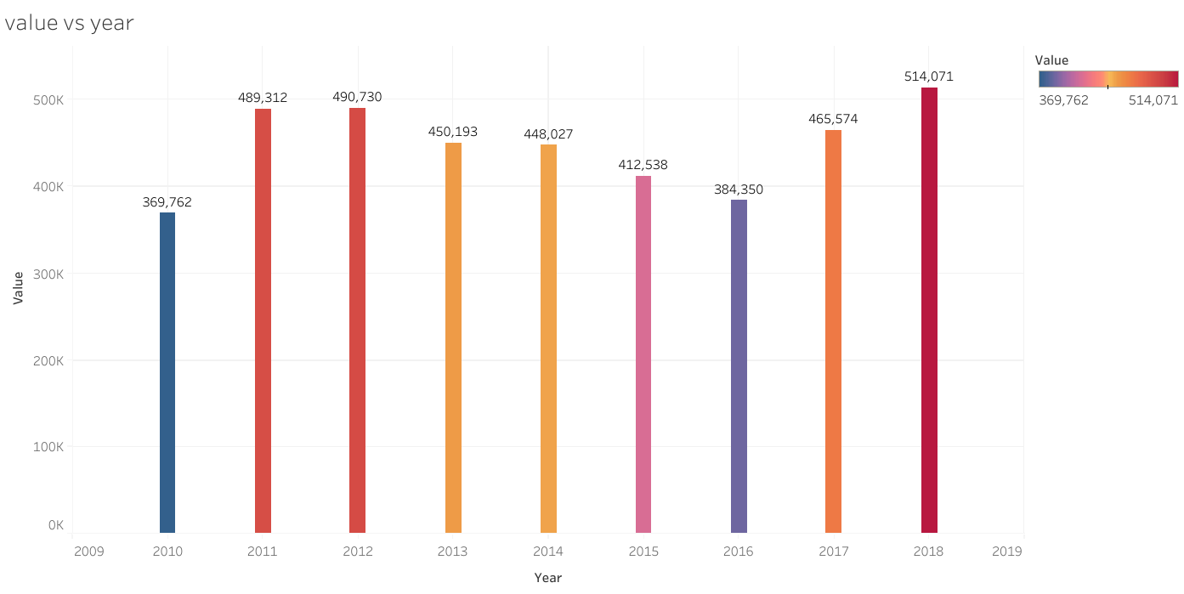
What is the total value of all traded goods in each year?
Major increase from 2010 to 2011. Afterwards, the total value of traded goods decreases from 2012 to 2016. Then it starts increasing again through the rest of the time period.

Slide 6
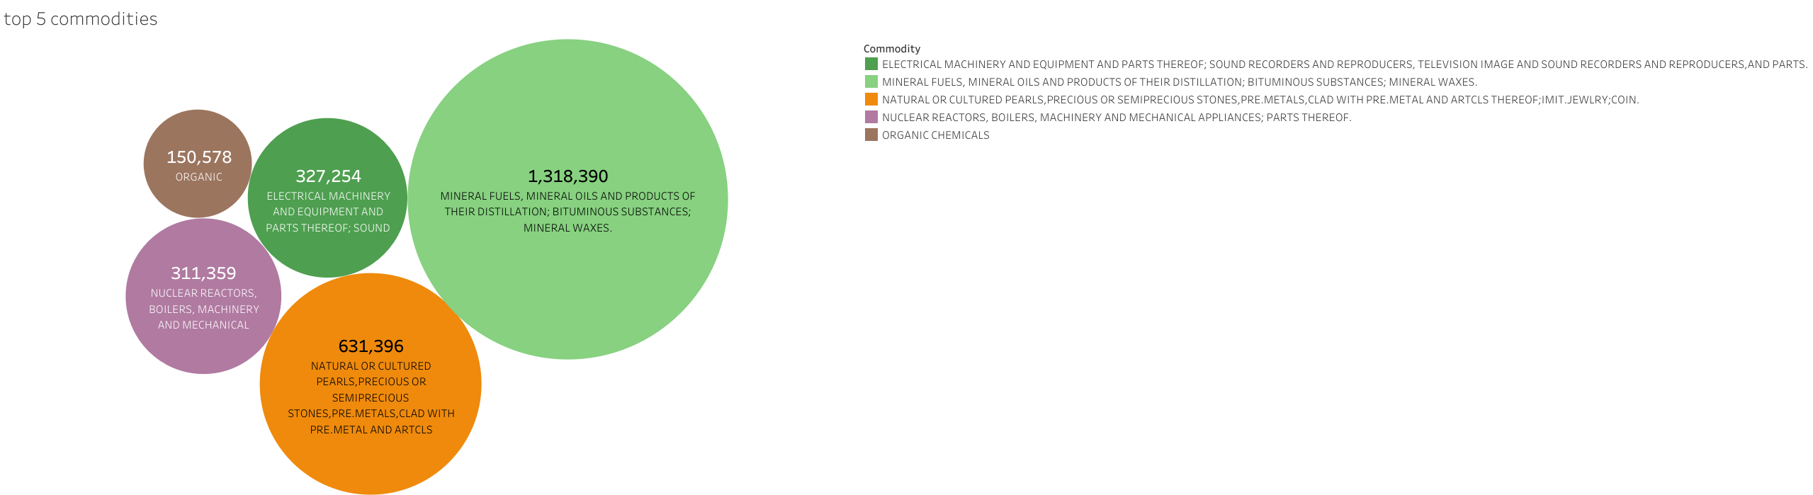
Which are the top 5 categories in imports?
Minerals and oil trade has the biggest share in imports to India. Followed by precious and semi precious metals, which has about half the value of minerals and oils.

Slide 7
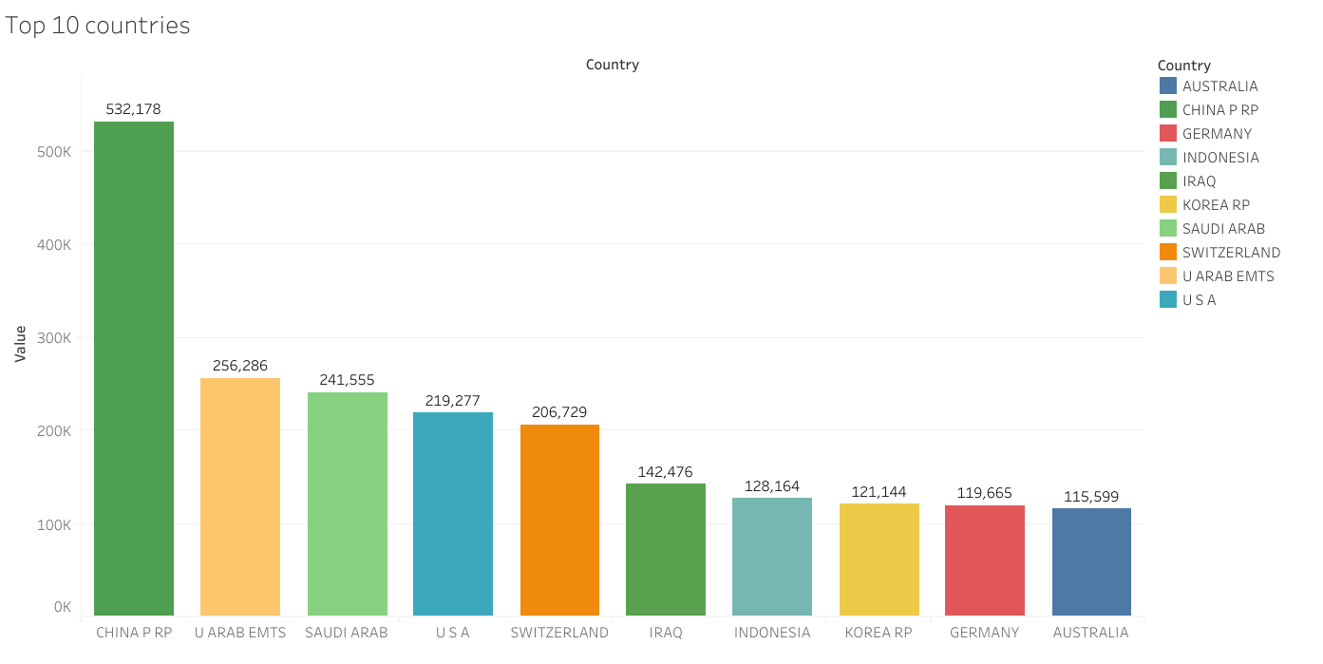
Which are top 10 countries in terms of total value of trades throughout the entire time period?
China is the highest with almost double the value of UAE.

Slide 8
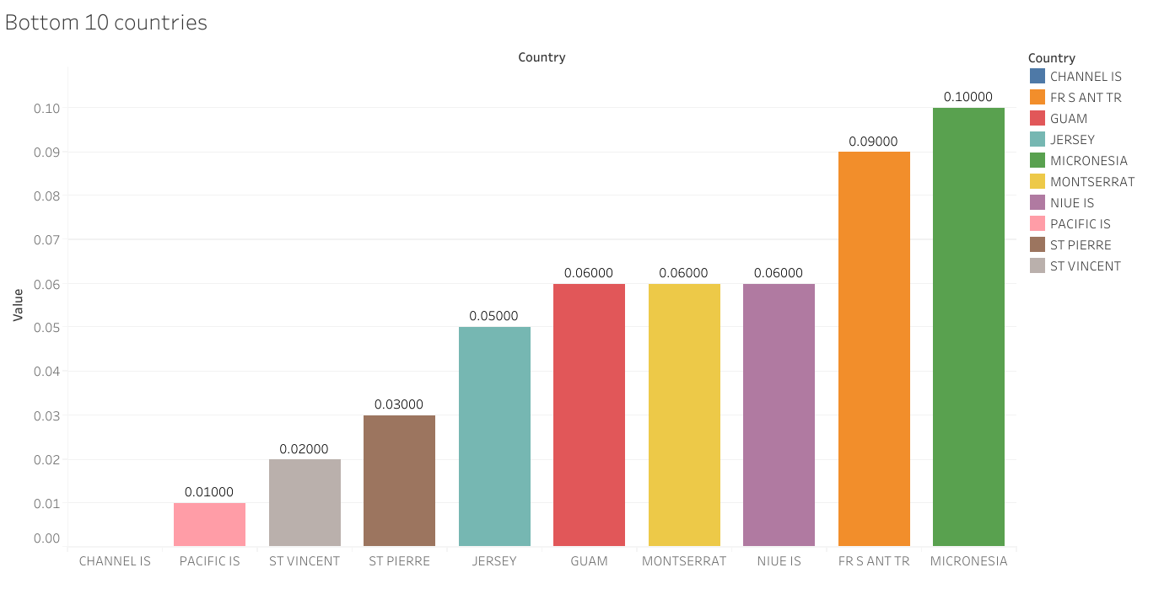
Which are the least active countries in imports to India?
Exposes some drawbacks of the dataset. Null values and extremely low values for all countries here.

Slide 9
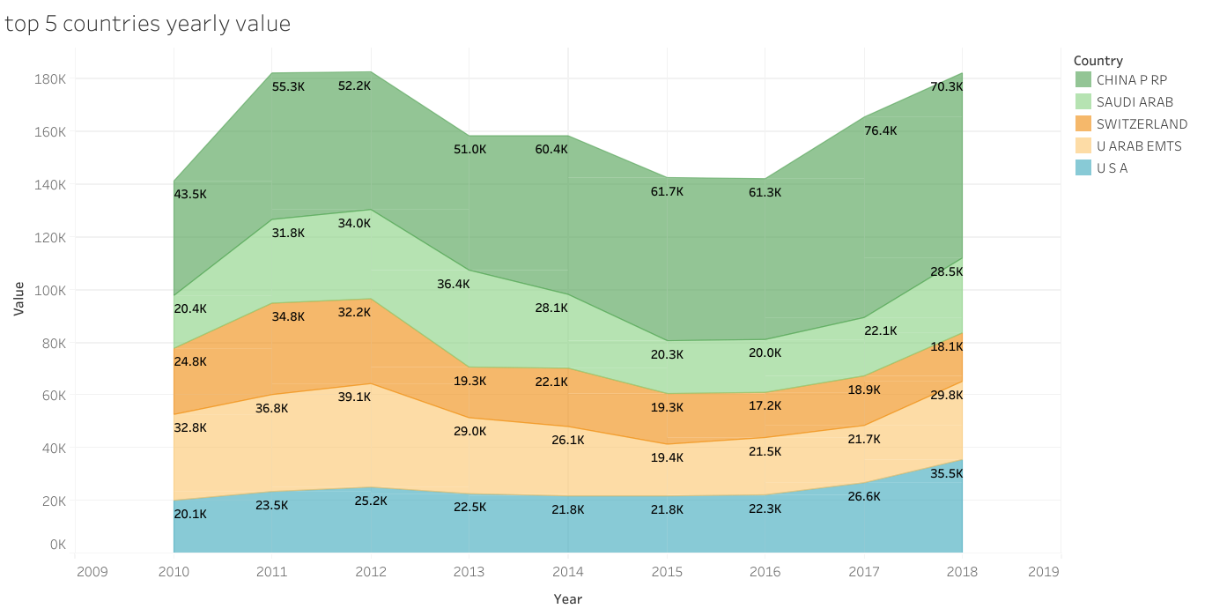
Top 5 countries in each year in terms of value of total traded goods throughout the time period?
Top 5 countries remained the same in all the years. The trend seen in total imports in each year is followed in this chart as well.

Slide 10
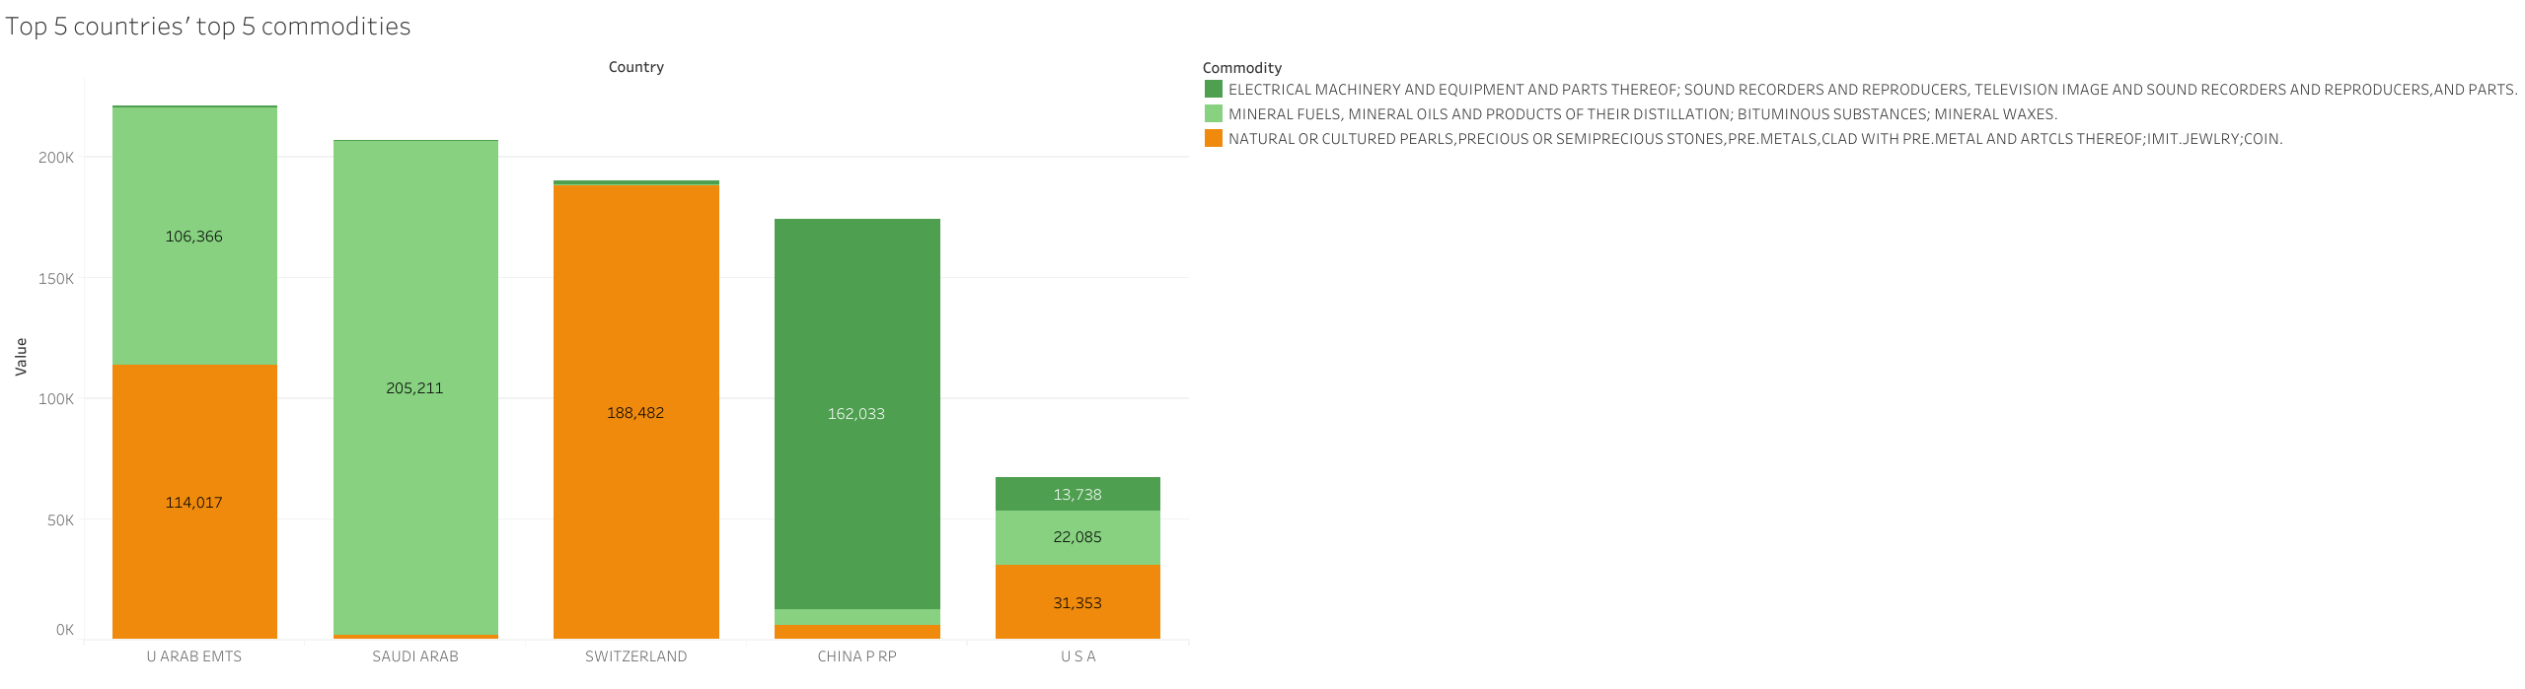
Which are the top 5 categories of trading of the top 5 countries?

